Slide 1

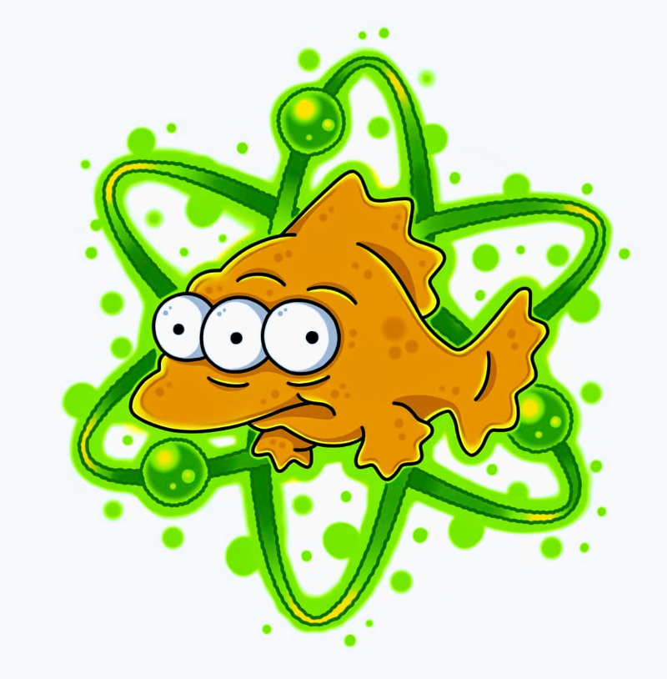
Do your fish glow?
The new NORM in Mining Assessments
Louise Crawley Senior Environmental Geochemist GEMG Conference June 2023

Slide 2
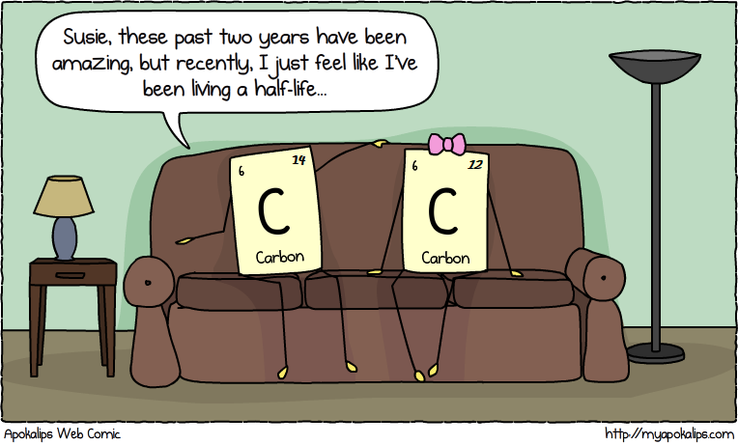
Do your Fish Glow?
Notes:
I am Louise Crawley, a Senior Environmental Geochemist for MBS Environmental in Perth.
Today I will be briefly discussing NORM in mining with particular focus on environmental impacts, current legislation and how NORM can be included in environmental risk assessments.

Slide 3
Do your Fish Glow? Overview
Radiation Overview
What is Radiation? What is NORM?
How is it related to mining?
Legislation
Governing bodies for radiation
Current legislation for radiation in Mining
Risk Assessments and Case Studies
When and why are risk assessments required?
Case studies of NORM in mining
Notes:
In this talk I will
An overview of radiation, NORM, and how it relates to mining
Discuss governing bodies and legislation regarding radiation in mining,
Discuss risk assessments with regards to radiation, and
Provide an overview of two case studies of NORM in mining in WA.

Slide 4
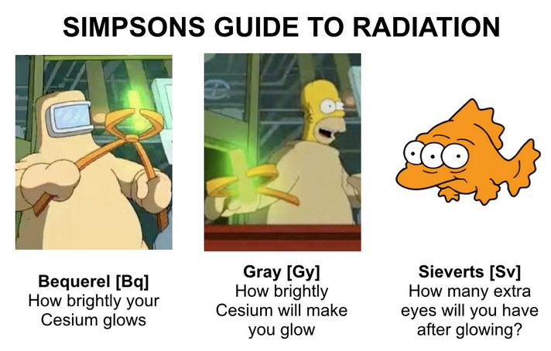
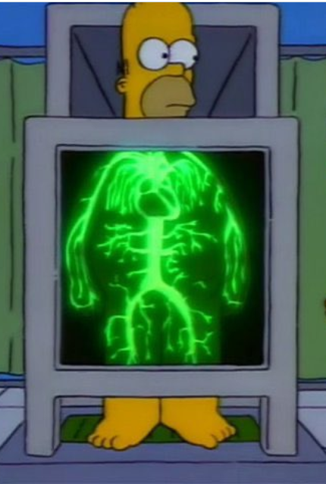
Do your Fish Glow?
What is Radiation?
How brightly radium will make YOU glow
How many extra eyes will you have after glowing?
How brightly your radium glows
YOU
Notes:
To keep it simple - Radiation is the breakdown or disintegration of unstable atoms.
There are a number of units for radioactivity. The main ones to be familiar with are:
Bq – This is the activity of a material and is how many times an atom disintegrates (or decays) per second. The higher this number the more radiation is being released.
Gy – Grey is used to describe the absorbed dose – energy received per kg.
Sv – A sievert is the effective dose - used to represent the health risk of ionizing radiation. Usually denoted in milli-seiverts.

Slide 5
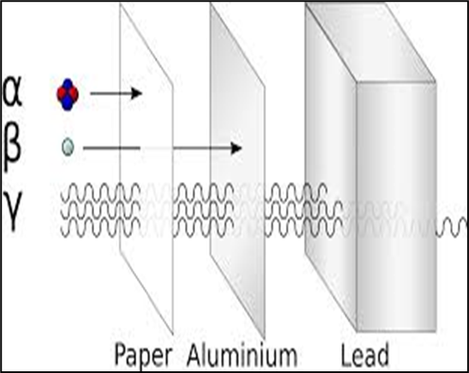
Do your Fish Glow?
What is Radiation?
Types of Radiation
Alpha (α)
High ionizing energy
Low penetration
Beta (β)
Moderately high ionizing energy
Low to moderate penetration
Gamma (ϒ)
Low ionizing energy
High penetration
Notes:
Three main types of radiation: Alpha, beta and gamma
Alpha and beta radiation have high ironizing energy that can do some serious damage to tissues, but they do not travel very far through physical materials, such as skin.
Gamma radiation has a much lower ionizing energy compared to alpha and beta radiation, but it has the ability to travel through physical materials.

Slide 6
Do your Fish Glow?
What is NORM?
NORM – Naturally Occurring Radioactive Material
Radioactive materials that are naturally elevated in groundwater, soils, sunlight and rock.
Some areas on the globe have higher natural levels of radiation than others.
NORM is typically uranium-235 and thorium-232 decay series (among others!).
Average global dose: 1 mSv to 13 mSv
Average dose in Australia: 1.5 mSv (mostly solar radiation)
(ARPANSA 2021)
Notes:
NORM is Naturally Occurring Radioactive Material.
NORM is the naturally occurring background radiation within the environment that people are continuously exposed to. Sources of naturally occurring background radiation include rocks, soil, food, and sunlight.
The two main radioactive elements are uranium and thorium which occur naturally in minerals across the planet.
In Australia, on average a human receives around 1.5 mSv of radiation exposure per year from natural sources such as sunlight.

Slide 7
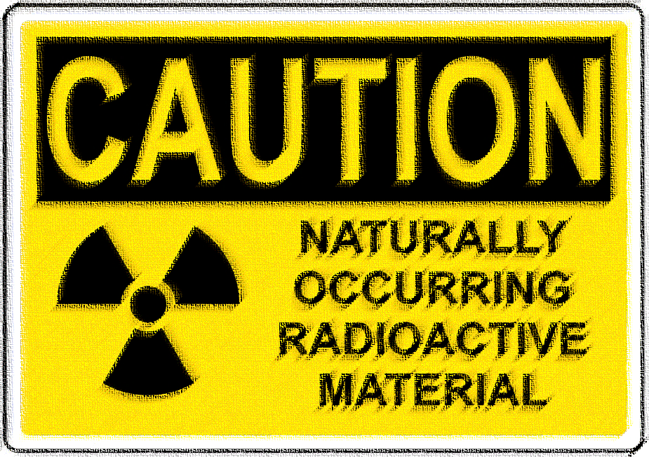
Do your Fish Glow?
NORM in Mining
Presence of Uranium and/or thorium in deposits of economic interest due to the geological association with certain minerals
Mineral Sands
Pegmatite / Lithium
Rare Earths
Potential for radioactive material to concentrate to hazardous levels through mineral processing into ore or waste streams
Potential to alter or impact environmental and human health
Radiation is a sensitive topic! Poorly understood by the general public. Perceived risk!
Notes:
Uranium and thorium are found all over the world in soils and bedrock in varying concentrations.
As with other elements, the presence of uranium or thorium will be higher or lower due to the specific geological processes that have occurred in that area.
Uranium and thorium are commonly associated with mining of:
Mineral sands
Rare earths and
in some cases, pegmatite/lithium.

Slide 8
Do your Fish Glow?
Radiation Governing Bodies
International
UNSCEAR
United Nations Scientific Committee of the Effects of Atomic Radiation
ICRP
International Commission of Radiological Protection
IAEA
International Atomic Energy Agency
Australia
ARPANSA
Australian Radiation Protection and Nuclear Safety Agency
Australia Other
DCCEEW
Department of Climate Change, Energy, the Environment, and Water (Federal)
Western Australia
RCWA
Radiation Council Western Australia
WA Other
EPA
Environmental Protection Agency (WA)
DMIRS
Department of Mines, Industry, Regulation and Safety
Notes:
Radiation protection in Australia is overseen by ARPANSA – Australian Radiation Protection Agency.
ARPANSA prepares:
National policies
Codes of practice and standards
Radiation protection in Australia is regulated at a State and Territory level.
In Western Australia:
Radiological Council (RCWA) and Department of Mines, Industry, Regulation and Safety (DMIRS) the regulating organisations.
A memorandum of understanding exists between the RCWA and DMIRS in relation to their responsibilities.
DWER are familiar with and refer to the ARPANSA guidelines with regards to the environment.
While the EPA and DECCEWW liaise with RCWA and DMIRS with regards to environmental radiation issues.

Slide 9

Do your Fish Glow?
Radiation Legislation – Western Australia
Legislative articles from the Radiological Council WA include:
Radiation Safety Act 1975 (RSA).
Radiation Safety (General) Regulations 1983.
Radiation Safety (Qualifications) Regulations 1980.
Radiation Safety (Transport of Radioactive Substances) Regulations 2002.
Legislative articles from DMIRS include:
Work Health and Safety (mines) Act 2022
(Replaces Mines Safety and Inspection Act 1994)
Work Health and Safety (mines) Regulations 2022
(Replaces Mines Safety and Inspection Regulations 1995)
Notes:
RCWA is primarily focussed on protecting members of the general public from exposure to harmful radiation levels.
This includes:
Medical and industrial processes
transport of radioactive material
And radioactive waste.
DMIRS primary focus is on the mining and processing of radioactive ores on mine sites, and the associated exposure of workers at the mining operations and controlling potential exposure to members of the public associated with the mining process.
Both RCWA and DMIRS are primarily focused on human health aspect and not the environment in terms of radiation and NORM.

Slide 10
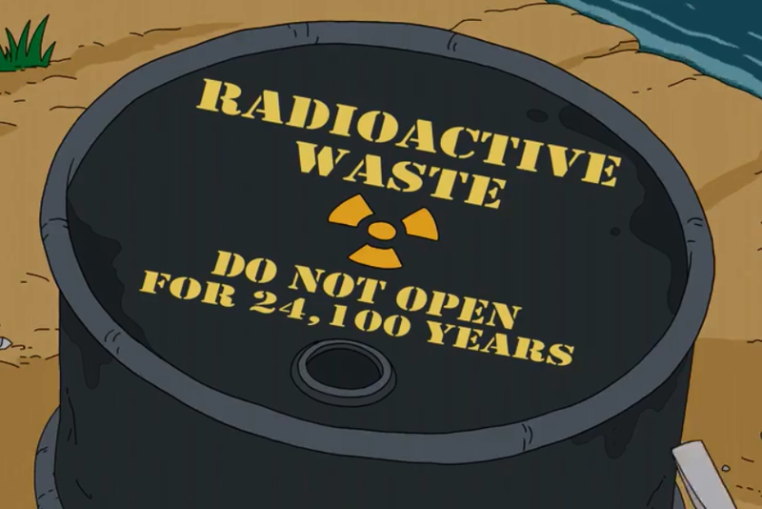
Do your Fish Glow?
Federal EPBC Act and Regulations
Legislation prepared by DCCEEW:
Environment Protection and Biodiversity Conservation Act 1999
Environment Protection and Biodiversity Conservation Regulations 2000
Nuclear Action
A nuclear action is defined as having:
Material with an activity greater than 10⁶ [Bq]
AND
an activity concentration greater than 1 [Bq/g].
If Activity conc: 1 Bq/g
Total activity: 10⁶ Bq
1,000 tonne
If Activity conc: 10 Bq/g
Total activity: 10⁶ Bq
100 tonne
Notes:
If there is a possibility of elevated NORM, mining companies may need to look at these regulations and determine if their projects classify as a nuclear action.
Example 1: Th/U concentration of 1Bq/g – Considered “inherently safe to humans” – requires 1,000 tonne of material for Nuclear Action
Example 2: Th/U concentration of 10 Bq/g – Dangerous Goods limit – only requires 100 tonne for Nuclear Action (not much really)

Slide 11
Do your Fish Glow?
EPBC Act and Regulations
So, what if the site classifies as a nuclear action?
Environmental Radiation Risk Assessment
Low Risk to the Environment May not need to be a “controlled action”
EPBC Referral may not be required
High Risk to the Environment May need to be a “controlled action”
Need an EPBC Referral
Notes:
Does your site classify as a nuclear action? What next?
If your site does technically classify as a nuclear action according to the EPBC Act and Regs, it doesn’t necessarily mean that the site needs to have an EPBC referral.
The next course of action is to undertake an environmental risk assessment to determine the risk of storage of the radioactive material on your site. This will determine if the nuclear action classification is significant or not.
If its high risk then a referral is likely needed. If the risk is low then a referral is unlikely not required.
Need to prove to EPBC that a referral based on nuclear action is not required.

Slide 12
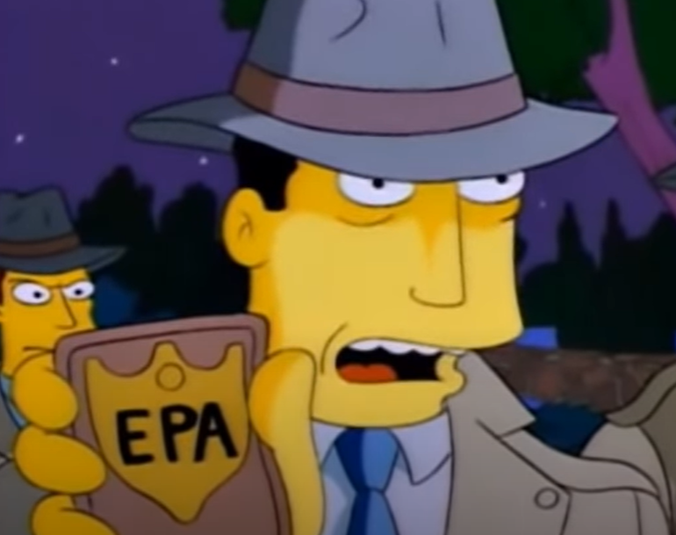
Do your Fish Glow?
Environmental Protection Agency (EPA)
Environmental Protection Act 1986
EPA defers assessment to DMIRS and RCWA
Once a proposal is approved, DMIRS and the RCWA
also play a role in regulation potential impacts from Radiation.
If potential impacts from radiation not significant:
Part 5 of the EP Act 1986
RIWA Act 1914
Radiation Safety Act 1975
Work Health and Safety (mines) Act 2022
Mining Act 1978
Notes:
EPA tends to defer assessments to DMIRS and RCWA.
Once approved, DMIRS and RCWA play a role in regulating potential impacts from radiation.
If potential impacts from radiation are assessed as not significant, regulation is managed under Part 5 of the EP Act 1986, RIWA Act 1914, the Radiation Safety Act 1975
When it comes to radiation, the EPA still provides significant advice on the management of Key Factors – particularly Rehabilitation and Closure and relevant management planning.

Slide 13

Do your Fish Glow?
Risk Assessments
Environmental and human health assessments should be completed for both
operations and post-closure.
Assessments should include potential impacts on:
Human Health (both workers and public)
Environment
Other land use (including post-closure land use)
Risk assessments should include:
Tier 1 – High level
Tier 2 – Includes relevant dose levels for each source-pathway-receptor.
Modelling software ERICA and/or RESRAD can be utilised for Tier 2 and Tier 3 risk assessments.
Notes:
Risk assessments should look at potential impacts to:
human health – both workers and public.
The environment – this includes the general health of the environment such as impacts groundwater, lakes, rivers, soils, and sediments. The impacts to flora and fauna either directly or from impacts to the environment.
Other land use – This includes impacts to agriculture industries either locally or as a post-closure land use. And how does this impact affect the end user such as consumers?

Slide 14
Do your Fish Glow?
Risk Assessments
NORM Considerations
What are the background levels of NORM (soil, rock and water) in the area?
Will the material undergo processing?
If so, will the NORM concentrate into separate waste streams?
Is decay chain equilibrium affected by chemical processes (heat or acids)?
What are the process and waste streams and what are the activity levels in each stream?
How is the material to be stored, transported or disposed?
Notes:
Once the characteristics of the materials are understood, the potential environmental receptors on or adjacent to site need to be determined.
This will usually involve using information from a flora and fauna survey and other environmental surveys that are typical of obtaining mining approvals.

Slide 15
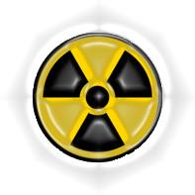
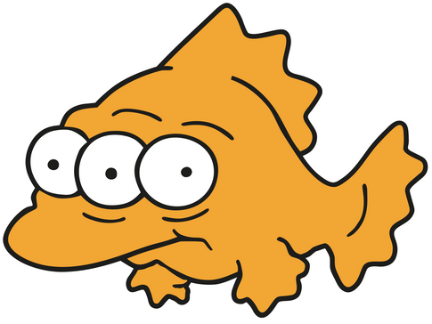
Do your Fish Glow?
Risk Assessments
Sources-Pathway-Receptors
Potential sources
Tailings / TSF
Ore
Waste Rock
Process Water
Groundwater
Solids - screened for U/Th concentrations
Water - screened for U/Th and gross alpha, beta and/or Ra226, Ra228
Potential pathways
Dust Generation / Inhalation of dust
Contamination of soils/vegetation
Ingestion of vegetation
Use of impacted groundwater
Irrigation
Ingestion of groundwater
Proximity to radiation sources (gamma)
Potential receptors
Human Health
Workers
Local Public
Environment
Flora and fauna
Migrating wildlife
Groundwater
Rivers and Lakes

Slide 16








Do your Fish Glow?
Risk Assessments Source-Pathway-Receptor
Inhalation of dust
Local Community
Gamma Radiation
Dust Generation
Inhalation of dust
Ingestion of groundwater
Mine Workers
Deposition onto soils
Contamination of soils
Ore / waste stockpiles TSF, Waste Dump etc.
Soils
Uptake and bioaccumulation by plants
Groundwater Use
Seepage to Groundwater
Uptake by local plants
Key:
Environmental Pathway
Human Health Pathway
Groundwater
Notes:
Input example source-pathway receptor

Slide 17
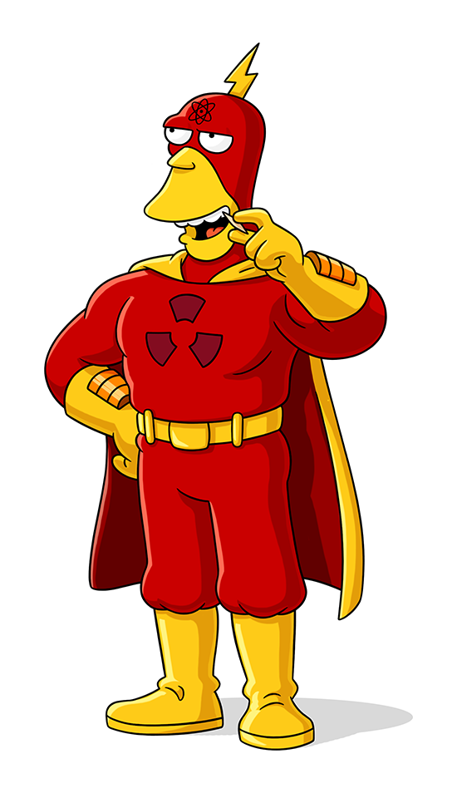
Do your Fish Glow?
Risk Assessments Operations
Potential Human Health Exposure Pathways during Operations:
Breathing airborne dust (α and β radiation)
Exposure to stockpiles (ϒ radiation)
Exposure within high-risk areas of the processing plant (ϒ radiation)
Potential Environmental Exposure Pathways during Operations:
Discharge or seepage to groundwater
Soil/sediment contamination from dust generation or during material loading activities, transport, or inadequate storage.
Notes:
Read off slide.

Slide 18
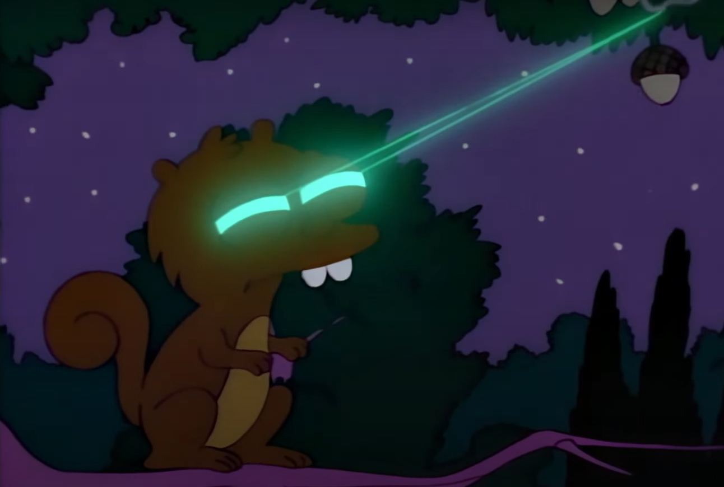
Do your Fish Glow?
Risk Assessments Post-Closure
Potential Human Health Exposure Pathways post-closure:
Dust generation from stockpiles Inhalation of dust by local residents (α and β radiation).
Perceived risk to public is important!
Potential Environmental Exposure Pathways post-closure:
Seepage to groundwater from waste landforms
Seepage into pit lakes Ingestion of water by fauna (α and β radiation)
Proximity to high activity waste landforms
Exposure to local native fauna (ϒ radiation)
Exposure to burrowing animals (Radon gas - α and β radiation)
Notes:
Read off slide.

Slide 19

Do your Fish Glow?
Case Study # 1
Baseline studies are important!
Background
Limited baseline analysis completed on groundwater.
During operations groundwater was being used for dust suppression (as per DWER license).
Groundwater fed into RO plant.
Monitoring survey later identified elevated concentrations of uranium.
Additional testing identified elevated gross alpha and beta and radioisotopes of radium in the groundwater and RO Reject water.
DWER amended the water license restricting the use of groundwater as dust suppression.
Notes:
Spodumene Mine
- Prior to commencement of mining operations groundwater for the site was analysed for physical properties such as pH, salinity etc.
The site was using groundwater for dust suppression as per the DWER license.
A monitoring event during operations identified elevated natural concentrations of uranium in the groundwater. Not caused from the mining activity.
Further testing also identified elevated levels of gross alpha and beta and radioisotopes of radium in the groundwater and the RO reject water.
As a result, DWER amended the water license which restricted the use of groundwater for dust suppression.

Slide 20
Do your Fish Glow?
Case Study # 1
Baseline studies are important!
The purpose of the assessment was to determine the risk of using RO reject water for dust suppression.
Dust suppression parameters / constraints adopted
Water Quality Data Reviewed
Dust suppression application rates estimated
Exposure Pathways
Sensitive Receptors
Ecological Values
Environmental Risk Determined
Dose Rates Modelled (ERICA)
Activity concentrations calculated
Notes:
Focus on slide – process
The assessment included
determining ecological values and receptors where dust suppression is required
identifying and assessing radionuclide exposure pathways
semi-quantitatively evaluating the magnitude of risk posed to ecological receptors.

Slide 21

Do your Fish Glow?
Case Study # 1
Baseline studies are important!
Outcome
Estimated dose rates were low.
Unlikely to yield any measurable effect at the population scale.
Considered low risk associated with past or future use of site water for dust suppression.
License was amended
Key Message
Complete adequate baseline studies and appropriate risk assessments prior to commencement of operations!
Notes:
Outcome
It was concluded that there is a low level of risk associated with past or future use of site water for dust suppression activities within the project area.
The licence was amended to allow dust suppression from RO

Slide 22
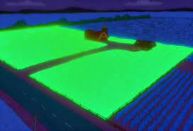
Do your Fish Glow?
Case Study # 2
Where's the Beef?
Background
Rare Earths Deposit containing elevated concentrations of uranium and thorium.
On-site processing and separation of ore would result in elevated uranium and thorium concentrations in tailings waste.
Post-closure activities expected to return to livestock grazing.
What would be the effect of elevated activity concentrations in
The TSF on livestock grazing?
Notes:
As part of closure, it was expected that the land would be used by local pastoralist for livestock grazing. With this in mind, the mining company wanted to look at the risk of the elevated activity on the proposed land use.

Slide 23
Do your Fish Glow?
Case Study # 2
Where's the Beef?
The purpose of the assessment was to determine the potential risks associated with the elevated activity concentrations in the TSF for cattle grazing.
Parameters / constraints for exposure pathways adopted
Vegetation intake rates by cattle
Cattle residence times near TSF
Consumer intakes of dairy and beef
Waste Data Reviewed
Environmental and Human Health Risks Determined
Dose Rates Modelled (ERICA)
Pathway 1 Vegetation Uptake
Pathway 2 Dose to cattle
Pathway 3 Accumulation in dairy and beef
Notes:
The project deposits contain naturally elevated concentrations of uranium and thorium.

Slide 24

Do your Fish Glow?
Case Study # 2
Where's the Beef?
Outcome
Dose rates to cattle were low and risk to cattle health was low.
Dose rates to consumers were low and risk to human health was low.
Overall, negligible risk pertaining to animal welfare, public health or food safety.
Roninhunt0987 – Deviant Art
Notes:
Outcome
The farmers who were to take over the land post-closure can be confident in the risks associated with mining on the land.

Slide 25
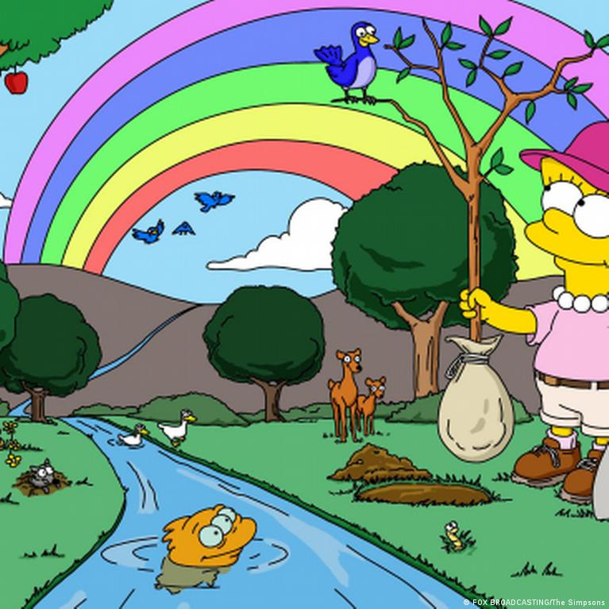
Do your Fish Glow?
Summary
Completing assessments early in the project will help prevent any hiccups in the long term
Risk assessments will help with the perceived risks of radiation impacts by the public.
Risk assessments can identify potential environmental issues and can reduce overall project costs.

